Slide 1
Beef Genetics
Morgan Hibbs

Slide 2
WHAT IS AGRICULTURE?
Food
Fuel
Fiber

Slide 3
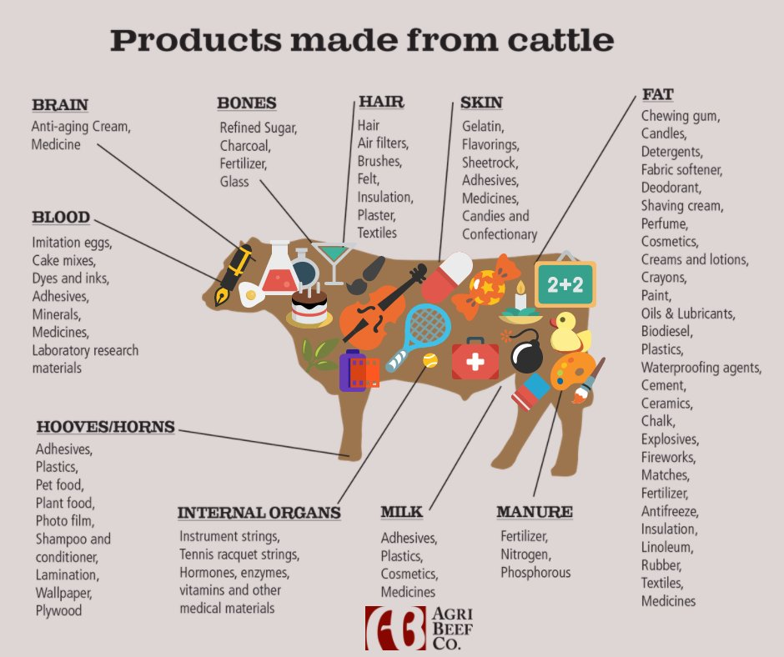

Slide 4
Dairy vs Beef: Shorthorn
Similarities and Differences?

Slide 5
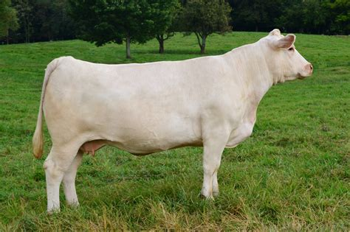
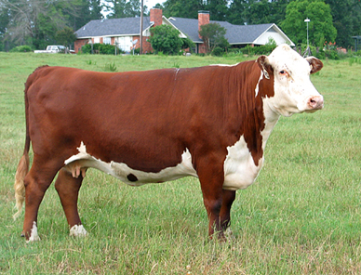
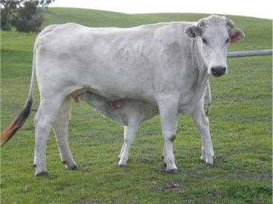
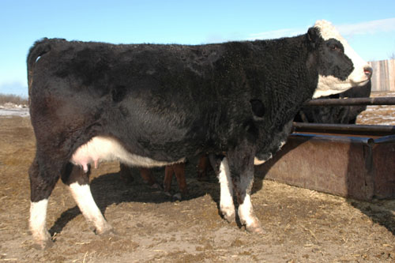
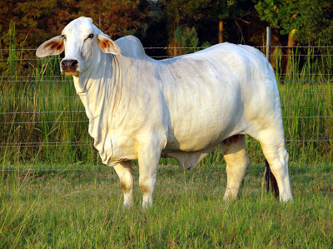
Beef Cattle Breeds
Angus
Charolais
Herford
Chianina
Simmental
Brahman

Slide 6
Preferred Traits
Marbling
Calving ease
Heat tolerant
Growth rate
Reproductive Performance
Structural soundness

Slide 7
Iowa Example: SimAngus
Created in the 20th century by the American Simmental Association
Simmental
- Superior weight gain
Maternal traits
Meat yield
Angus
Polled
Solid coat
Marbling

Slide 8
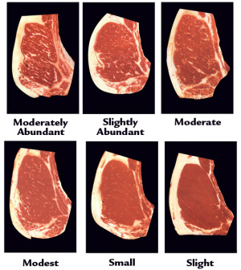
Preferred Traits

Slide 9
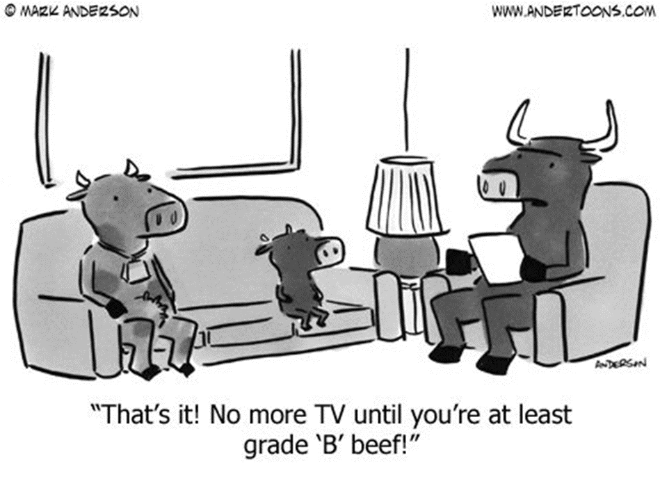

Slide 10
Create Your Own Herd
Now it is time to create your own herd! (15 minutes)

Slide 11
Livestock Genetics: Sheep

Slide 12
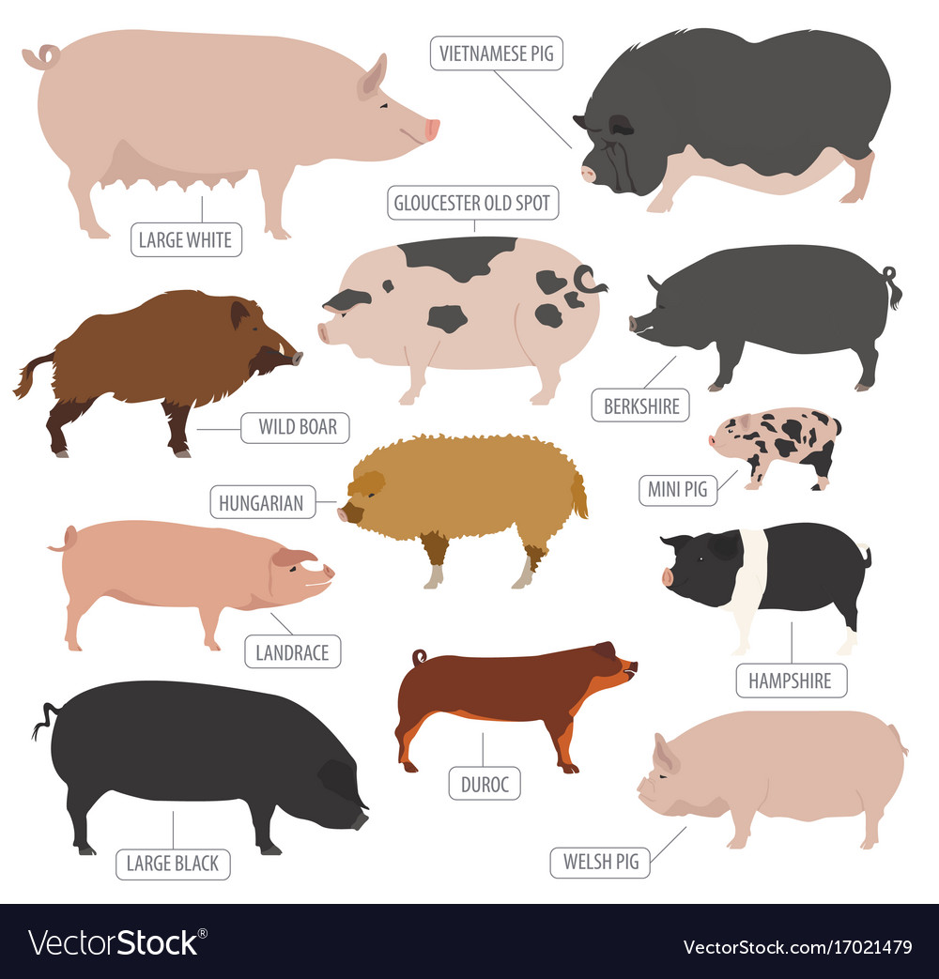
Livestock Genetics: Pigs

Slide 13
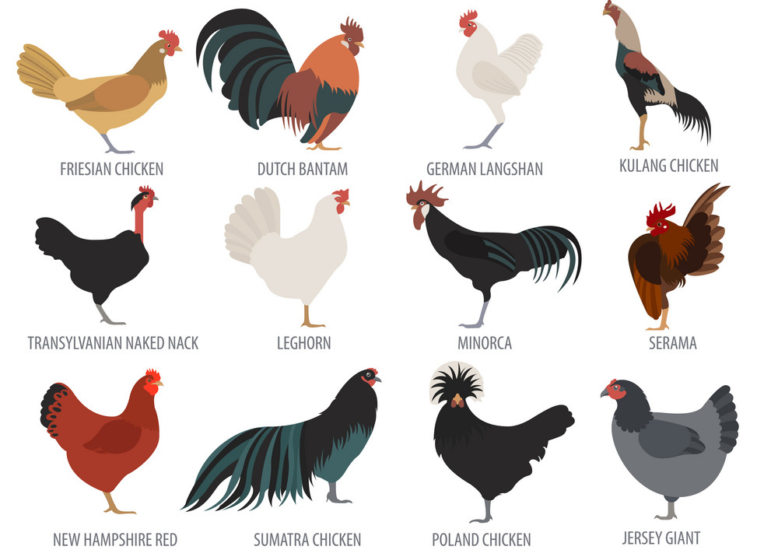
Livestock Genetics: Chickens

Slide 14
Plant Genetics: Corn

Slide 15
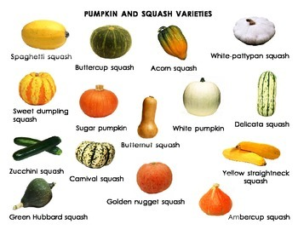
Plant Genetics: Squash

Slide 16
Thank you!

