Slide 1
Fueled by Soybeans!
Linn County Education Outreach
PowerPoint adapted from American Farm Bureau Foundation for Ag and Ford NAITC presentation

Slide 3
https://www.youtube.com/watch?v=J9OgpHGxDbY&feature=youtu.be

Slide 8
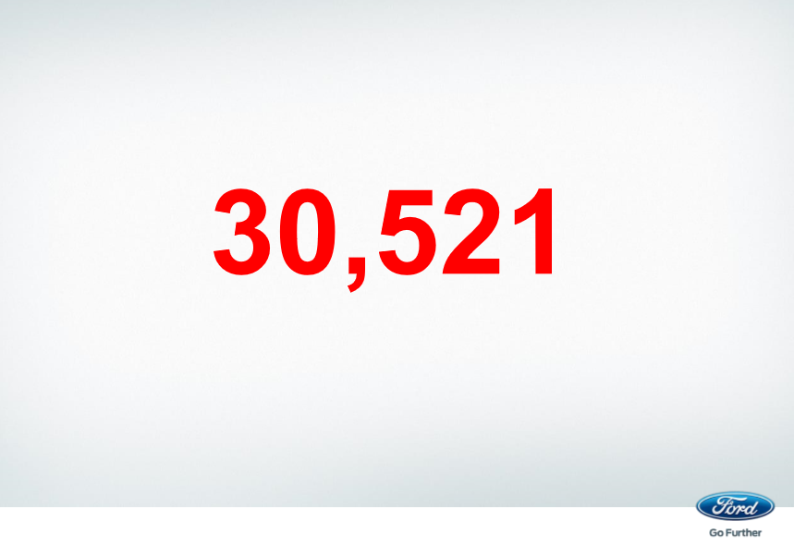

Slide 12
https://www.youtube.com/watch?v=Aa9d77hNN-0

Slide 14
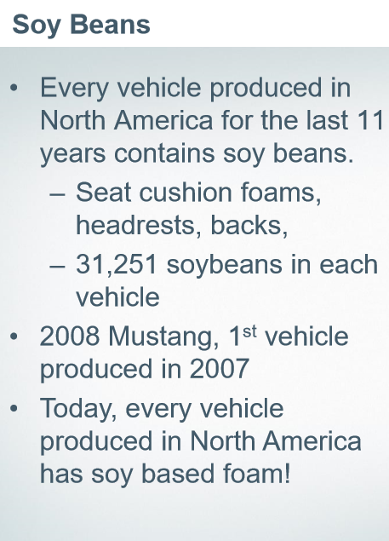

Slide 17
https://www.youtube.com/watch?v=pEwWgnJl6m4

Slide 18
Thank You!

