Slide 1

Fish Farm
Review quiz!

Slide 2
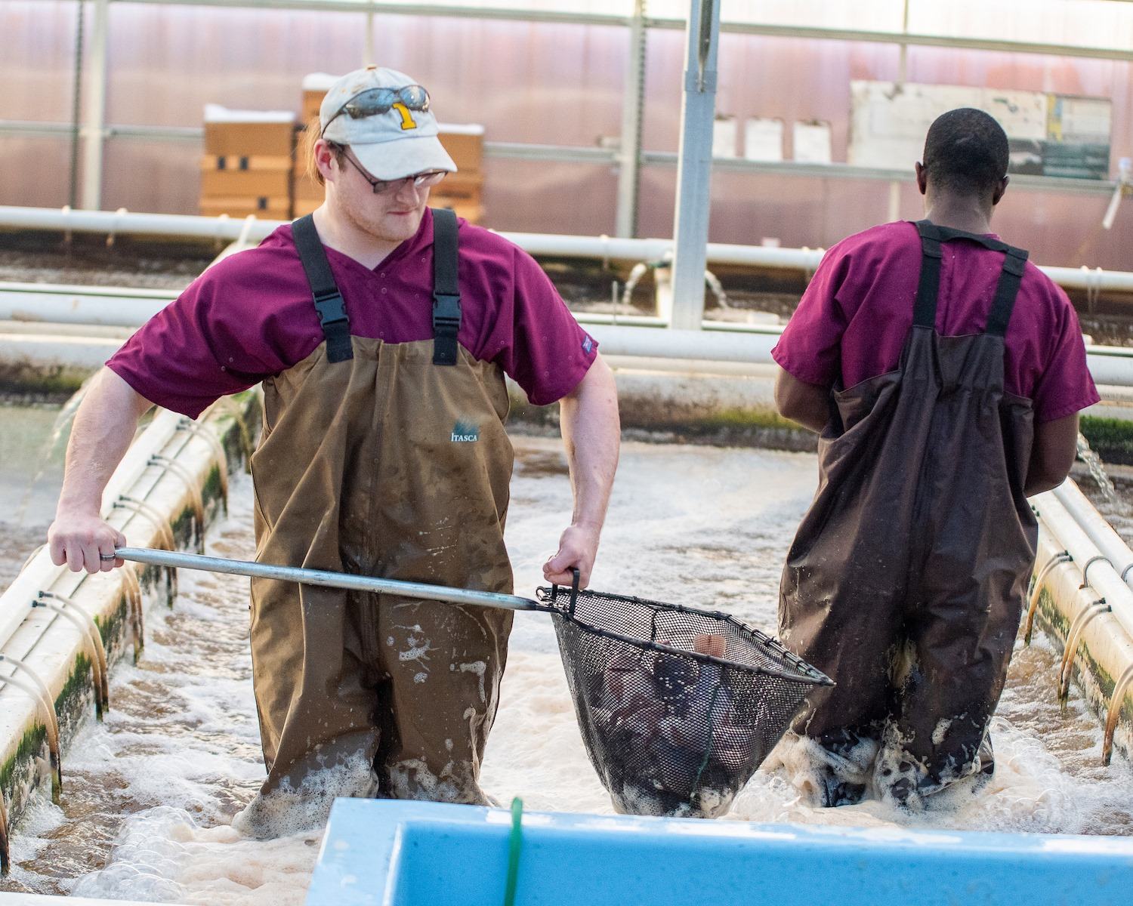
Question 1
Eagle’s Catch Iowa Fish Farm raised what kind of fish?
Cod
Tilapia
Catfish
Trout

Slide 3
Answer to #1
Tilapia

Slide 4
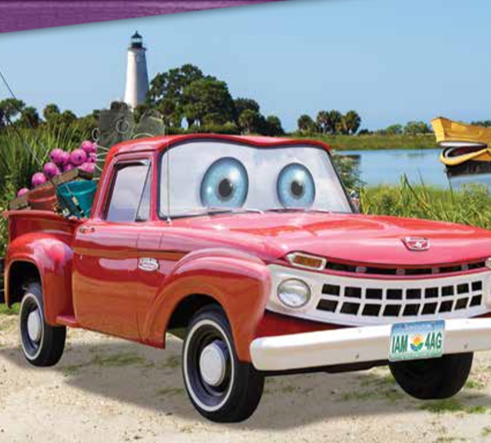
Question 2
What is aquaculture?
Water
Water-culture
Raising aquatic species
Farming

Slide 5
Answer to #2
Raising aquatic species

Slide 6

Question 3
Eagle’s Catch uses what system to raise their fish?
Tanks
Ponds
Open saltwater cages
Wild caught

Slide 7
Answer to #3
Tanks

Slide 8
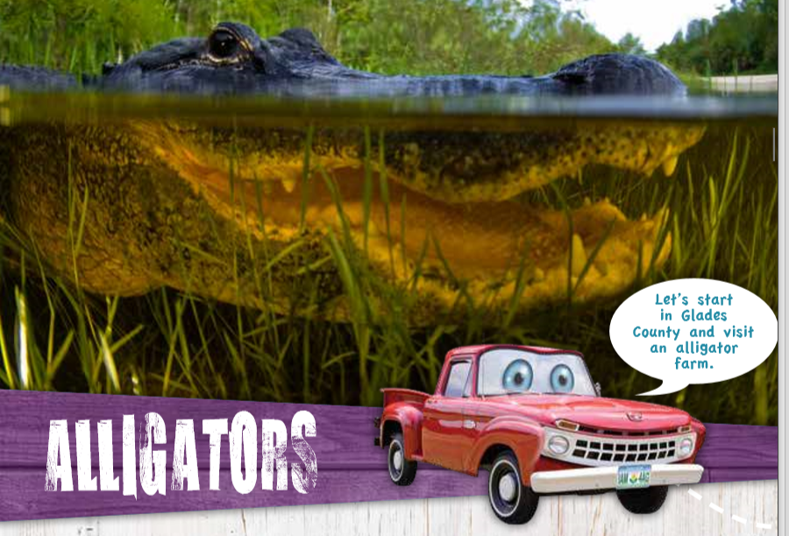
Question 4
Why do we raise alligators?
Milk
Meat and alligator skin
A and B
Fabric

Slide 9
Answer to #4
Meat and alligator skin

Slide 10
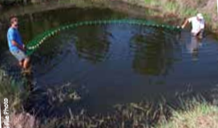
Question 5
Tilapia are raised in fresh or salt water?
Freshwater
Saltwater

Slide 11
Answer to #5
Freshwater

Slide 12
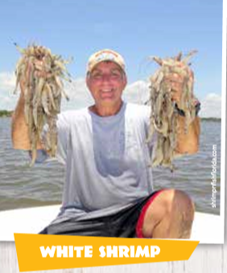
Question 6
The word “shrimp” stands for?
Jumbo
Tiny or small
Crustaceans

Slide 13
Answer to #6
Tiny or small

Slide 14
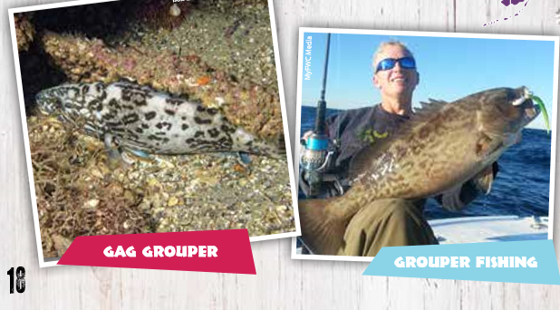
Question 7
How many kinds of grouper fish are there?
250
400
300

Slide 15
Answer to #7
400

Slide 16
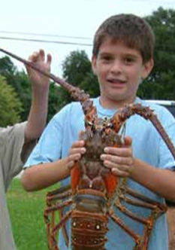
Question 8
Lobsters have how many legs?
15
5
10

Slide 17
Answer to #8
10

Slide 18

Question 9
Eagle Catch raises their fish indoors or outdoors?
Outdoors
Indoors

Slide 19
Answer to #9
Indoors

Slide 20
Question 10
Can Iowa farmers raise shrimp, tilapia, catfish, and other aquaculture species?
True
False

Slide 21
Answer to #10
True

