Slide 1
Hydroponic Farming Morgan Hibbs

Slide 2
How does it grow?
https://www.youtube.com/watch?v=tG9bV2enwI0&t=43s

Slide 3
What do plants need to survive and grow?

Slide 4
Water?
Sunlight?
Heat?
Soil?
Air?

Slide 5
Air, Water, & Heat
Air
Plants need carbon dioxide from the air in order to perform photosynthesis
Water
Plants need water in order to prevent dehydration
Heat
Plants need warm enough temperatures to keep their cells from freezing
Some plants can tolerate cooler or warmer temperatures than others
What about sunlight and soil? Do plants really need these to grow?

Slide 6
What about Sunlight and Soil?
Plants DO NOT need sunlight or soil to survive and grow!
Plants DO need nutrients and certain colors of light to survive and grow, but these don’t necessarily need to be provided by the sun or soil.
- Nitrogen (N)
- Phosphorous (P)
- Potassium (K)
Growing plants indoors without sunlight is made possible by specialized “grow lights,” which emit light of specific colors that are calibrated for plant use.

Slide 7
Growing Plants Without Sunlight and Soil?
Hydroponics:
Plant roots are suspended in nutrient-rich water.
Aquaponics:
Plant roots are suspended in water with fish and bacteria living in it to provide nutrients for the plants.
Aeroponics:
Plant roots are suspended in air and misted periodically with nutrient-rich water.
These three methods use much less water than traditional field farming.
Aeroponic farming can use up to 95% less water than field farming!

Slide 8
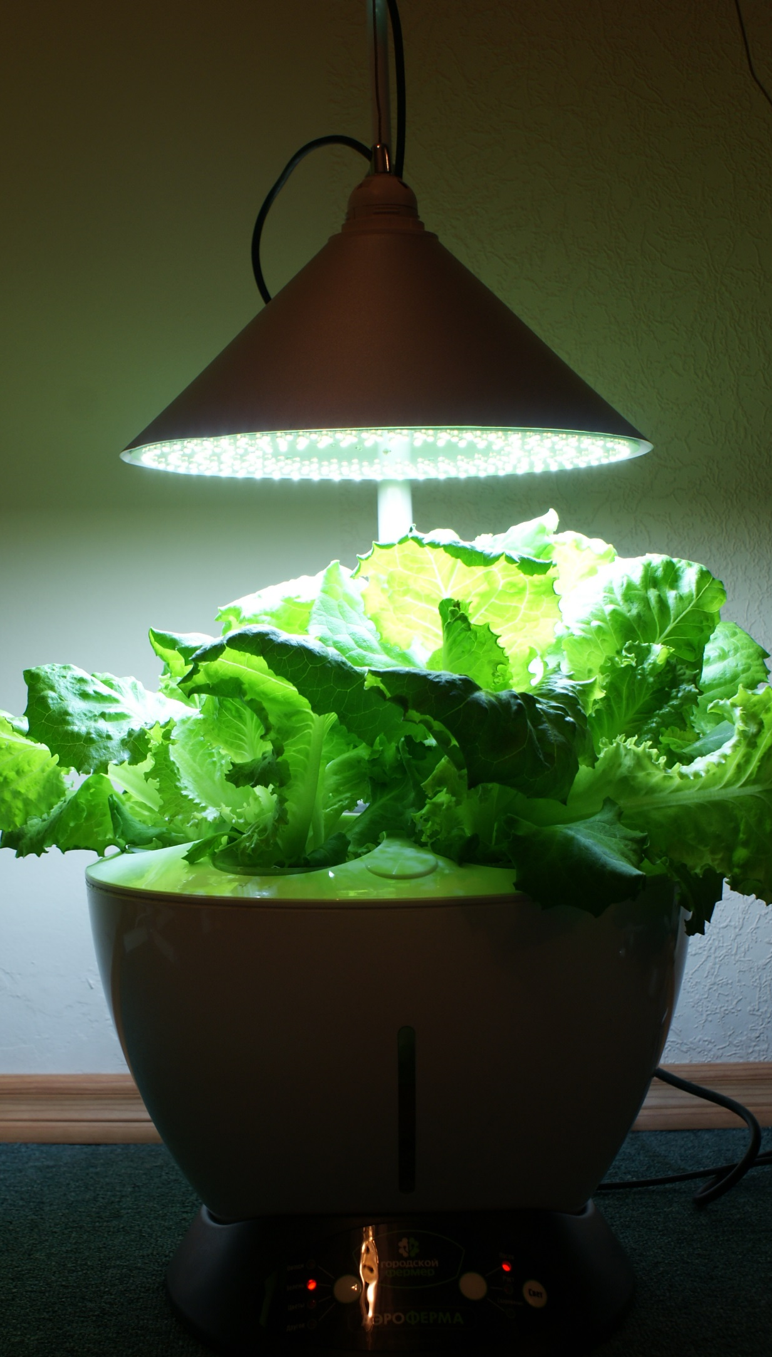
So What do Plants Really Need?
Air
Carbon dioxide is taken in by special openings in the plant’s exterior called “stomata”
Water
Taken up by roots and delivered to all parts of the plant
Heat
Not too hot, and not too cold, just like Goldilocks
Nutrients
Nitrogen, phosphorus, potassium, magnesium, sulfur, and other trace chemicals
Can be provided by soil or other means
Light
Mostly red and blue wavelengths
Can be provided by the sun or artificial lighting

Slide 9
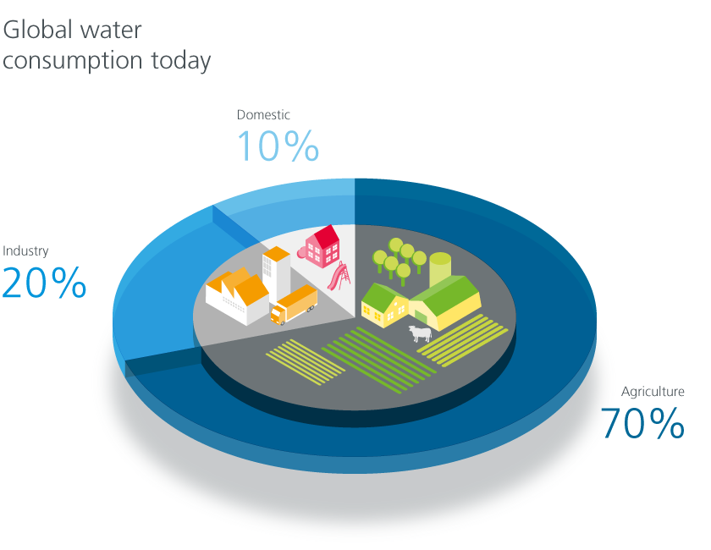
Why Hydroponics?
70% of fresh water globally is used for agriculture
By 2050, increased population may require as much as 15% more water to feed everyone
In the U.S., more than 80% of Fresh Water is used for agriculture, approaching 90% in some western states
Agricultural activity is the leading source of several fresh water pollutants, leading to species loss and decrease in drinking water quality
Notes:
Graph Source: https://www.gea.com/es/technology-talks/zero-water.jsp

Slide 10
Hydroponic Farming: Test tube hydroponic experiment

Slide 11
Pros and cons
Is hydroponics the solution to our problem?
Do you see flaws in the system?
How do you think it would work to grow other crops?

Slide 12
More videos:
https://www.youtube.com/watch?time_continue=60&v=rEw-VfFkUik
https://www.youtube.com/watch?v=-_tvJtUHnmU

