Slide 1
Pizz-A-Thon
Welcome!

Slide 2
A journey of how ingredients get to our pizza.
Have you wondered where pizza comes from?
I mean really wondered?
Where does the cheese, crust & toppings come from?

Slide 3
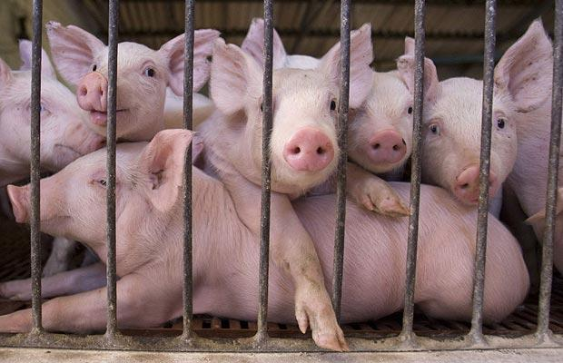
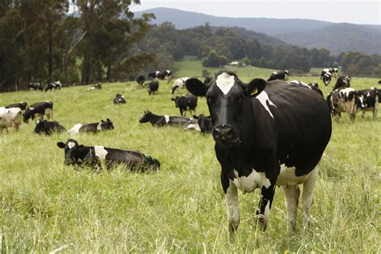
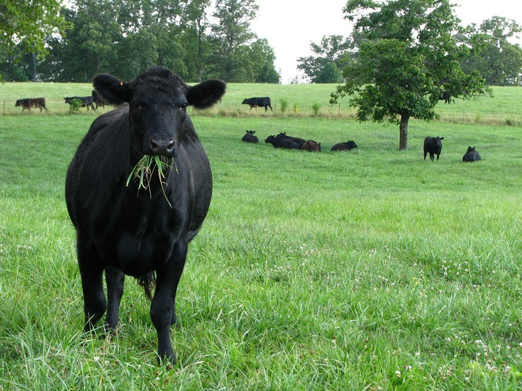
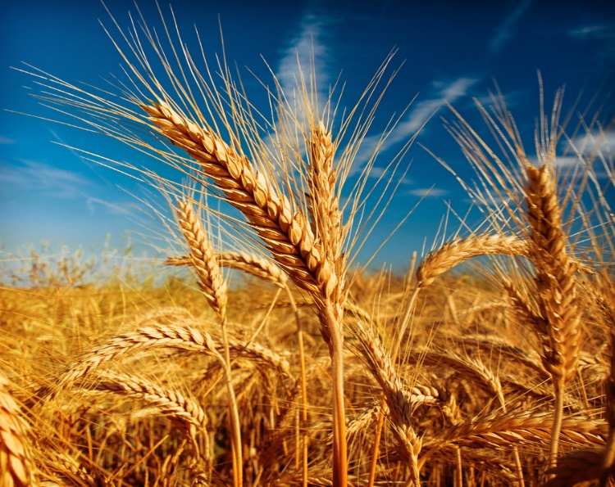
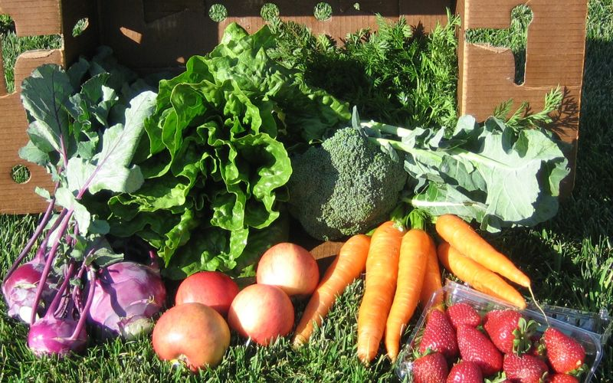

Slide 4
Introduction
You will be split you into small groups of 4-6 students.
Your challenge is to discover how pizza ingredients go from farm to slice!

Slide 5
How will I learn where my pizza comes from?
Tasks
Research Questions
You and your teammates will decide on a pizza to make.
Each of your teammates will choose an ingredient that you will research.
Where does my ingredient come from?
How does it grow?
How does my ingredient get on my pizza?
What states produce my ingredient?
Why is my ingredient healthy?

Slide 6
Competition
When your research is completed, you and your teammates will put together a PowerPoint presentation to present to the class.

Slide 7
Step 1
1. Ready to decide on a Pizza!
Choose 2 meat toppings: hamburger, sausage, pepperoni, ham/Canadian bacon, bacon or chicken
Chose 2 vegetable toppings: green peppers, mushrooms, pickles, black olives or onions
Choose 1 cheese topping: Mozzarella or taco blend

Slide 8
Step 2 and 3
2. Get pizza toppings approved by your teacher.
3. Decide who is going to research what.
Each teammate will take one ingredient role.
Ingredient roles:
Meat topping #1
Meat topping #2
Vegetable toppings (this teammate will research both vegetables and tomatoes for the sauce)
Cheese
Wheat (for the crust)
*If there are only four members in your group, then one teammate will research both meat toppings

Slide 9
Where do I keep my research?
Use a loose-leaf piece of paper, notebook or Word document.

Slide 10
Time to research!
It is time to research!
Please click on the websites that are next to your ingredient and answer your research questions.
You may have to look at all the websites to answer your questions!
Read the publications in your Pizz-A-Thon kit!

Slide 11
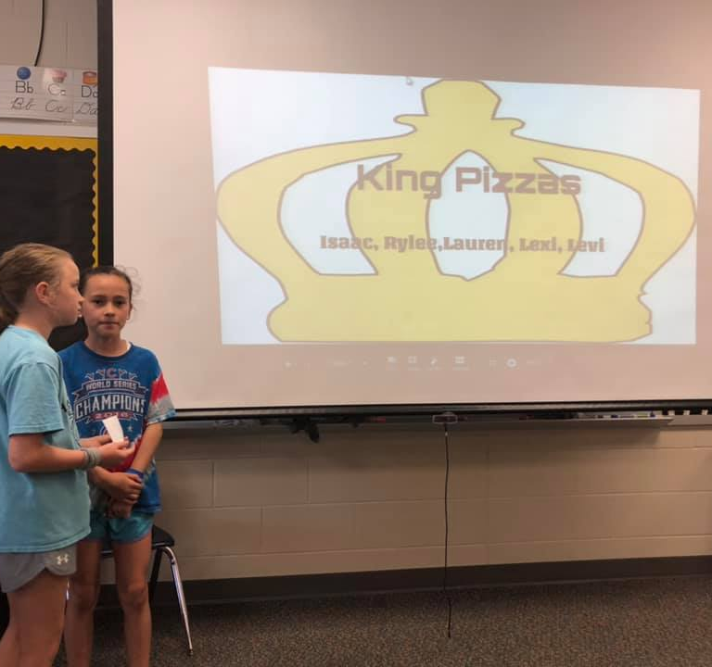
My research is done!
Choose a pizza company name. Be creative!

Slide 12
Ready for presentation
Create a group PowerPoint presentation.
Add pictures and your research.
Use easy to read font and colors.

Slide 13
Practice! Practice! Practice!
Begin practicing your presentation. Make sure you know what order everyone is speaking in. Each person will present their own research. Make sure your presentation is no longer than 6 minutes long.
Your research should answer the following questions:
Where does my ingredient come from?
How does it grow?
How does my ingredient get on my pizza?
What states produce my ingredient?
Why is my ingredient healthy?

Slide 14
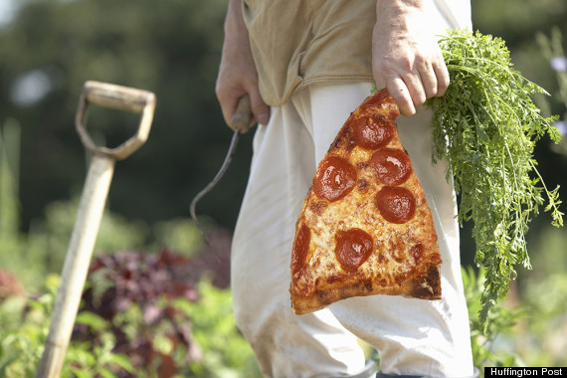
Pizz-A-Thon Competition

Slide 15
Beef
Videos:
Where does your cheeseburger come from? https://www.youtube.com/watch?v=wDqpCjoYN3k
Farm to Fork https://www.youtube.com/watch?v=y_QxKsG4wRY
Beef FarmChat https://www.youtube.com/watch?v=s2IY8AFYbTQ&list=PL6fqYHxqQAn1tohm6nIKuE6g6173TPywO&index=14
Beef FarmChat 2 https://www.youtube.com/watch?v=T8u4tywuct0&list=PL6fqYHxqQAn1tohm6nIKuE6g6173TPywO&index=20
Websites:
Iowa Beef Council https://www.iabeef.org/
Iowa Cattlemen’s Association https://www.iacattlemen.org/
Publications:
Illinois Ag in the Classroom Beef Ag Mag http://www.agintheclassroom.org/TeacherResources/AgMags/Beef%20Ag%20Mag%20for%20Web_FINAL.PDF

Slide 16
Dairy
Videos:
Dairy FarmChat https://www.youtube.com/watch?v=ikv_vXSZmwQ&list=PL6fqYHxqQAn1tohm6nIKuE6g6173TPywO&index=13
Cheese Making https://www.youtube.com/watch?v=y9wLhRrj5Ug
The Udder Truth http://www.uddertruth.org/
Websites:
Midwest Dairy https://www.midwestdairy.com/
Moo Milk http://www.moomilk.com/virtual-tour
Dairy Good https://dairygood.org/
Publications:
Illinois Ag in the Classroom Dairy Ag Mag http://www.agintheclassroom.org/TeacherResources/AgMags/2018%20Dairy%20Ag%20Mag%20Online%20Version_P.pdf

Slide 17
Pork
Videos:
Pork FarmChat https://www.youtube.com/watch?v=80RU6LJSYG4&list=PL6fqYHxqQAn1tohm6nIKuE6g6173TPywO&index=23
Pork FarmChat 2 https://www.youtube.com/watch?v=fW7RLQApY4U&list=PL6fqYHxqQAn1tohm6nIKuE6g6173TPywO&index=26
Pork FarmChat 3 https://www.youtube.com/watch?v=a5OeYruH0go
The Amazing Pig Farm https://www.youtube.com/watch?v=ouwJyvNwvpY
Ohio Pig Farm https://www.youtube.com/watch?v=rAw7Fs_IAW4&t=89s
Websites:
Iowa Pork Producers https://www.iowapork.org/
Finding common ground http://findourcommonground.com/food-facts/animal-welfare/
Publications:
Illinois Ag in the Classroom Pork Ag Mag http://www.agintheclassroom.org/TeacherResources/AgMags/AITC283J7%20Pork%20smartboard.pdf

Slide 18
Wheat
Videos:
Where does your cheeseburger come from? https://www.youtube.com/watch?v=wDqpCjoYN3k
Wheat Harvest https://www.youtube.com/watch?v=vT_VDYn1H-4&list=PLjPV5gImULPigmsUwhErFr0Vro58q1V3n
Websites:
Wheat from Farm to you! https://www.sites.ext.vt.edu/virtualfarm/wheat/wheat_farm_to_you.html#
Wheat facts https://www.wheatworld.org/wheat-101/wheat-facts/
Wheat production map https://www.wheatworld.org/wheat-101/wheat-production-map/
Publications:
Illinois Ag in the Classroom Wheat Ag Mag http://www.agintheclassroom.org/TeacherResources/AgMags/Wheat_Smartboard.pdf

Slide 19
Vegetables
Videos:
How does it grow? Tomatoes https://www.youtube.com/watch?v=VFfqgAeD5p4
How does it grow? Peppers https://www.youtube.com/watch?v=SwF7BGZkNQw&t=60s
Onions https://www.youtube.com/watch?v=2R0kzCwGNtw
How does it grow? Mushrooms https://www.youtube.com/watch?v=HLtGRHX0sLI
Olives https://www.youtube.com/watch?v=zG4Ms3lstd4
Websites:
Growing vegetables https://www.gardeningpatch.com/vegetable/gardeningpatch.com
Caring for vegetables https://bonnieplants.com/
All about onions https://www.onions-usa.org/all-about-onions/where-how-onions-are-grown
Publications:
Illinois Ag in the Classroom Horticulture Ag Mag http://www.agintheclassroom.org/TeacherResources/AgMags/Horticulture.pdf
Illinois Ag in the Classroom Specialty Crop Ag Mag http://www.agintheclassroom.org/TeacherResources/AgMags/Specialty%20Crops%20Ag%20Mag%20SPLIT%20for%204%20Pages.pdf

Slide 20
Nutrition
Websites:
Now that you know where your ingredient comes from, we need to know if it is healthy. Finish filling out the nutritional information part of your research.http://kidshealth.org/kid/stay_healthy/food/fgp_interactive.html http://kidshealth.org/kid/nutrition/food/vitamin.htm
How many servings should I have of my ingredient? Click on the website to see how many servings you should have in a day. http://en.wikipedia.org/wiki/File:USDA_Food_Pyramid.gif
Publications:
Illinois Ag in the Classroom Nutrition Ag Mag http://www.agintheclassroom.org/TeacherResources/AgMags/Nutrition%20Interactive%20Ag%20Mag3.pdf
Illinois Ag in the Classroom Pizza Ag Mag http://www.agintheclassroom.org/TeacherResources/AgMags/Pizza%20Ag%20Mag%202018%20for%20smartboard.pdf
State Agricultural Facts
https://www.agclassroom.org/teacher/ag_facts.cfm
http://www.beefusa.org/beefindustrystatistics.aspx
http://beef2live.com/story-top-10-states-cattle-0-110713
http://www.dairyfarmingtoday.org/Learn-More/FactsandFigures/Pages/StateStatistics.aspx
http://www.stuffaboutstates.com/agriculture/livestock/hogs.htm
https://www.pork.org/facts/stats/structure-and-productivity/state-rankings-by-hogs-and-pigs-inventory/
http://www.statista.com/statistics/190376/top-us-states-in-wheat-production/

