Slide 1
What am I?
I was first brought to the United States from China in 1765.
The United States now leads the world in my production.
75,000,000 acres of U.S. farmland are used to grow me.

Slide 2
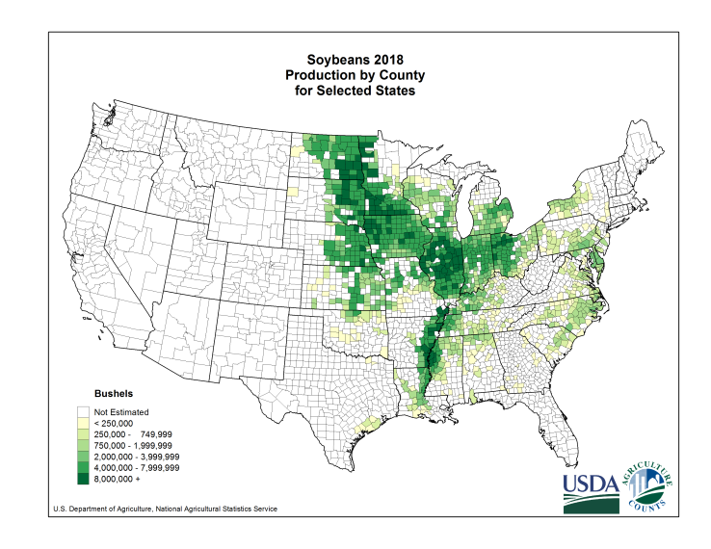
What am I?
This is where I am grown in the United States

Slide 3
What am I?
I am 18% oil and 38% protein.
Most baked breads, cookies, crackers, and cakes contain my oil.
I contain all eight amino acids, which are essential for human health.

Slide 4
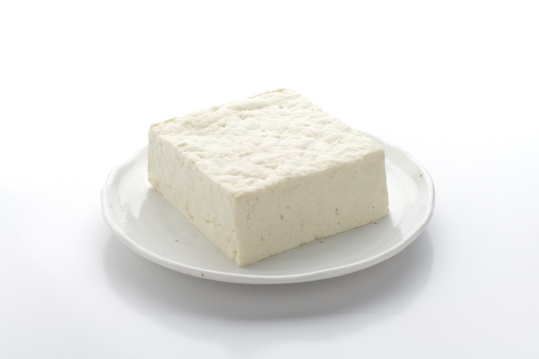
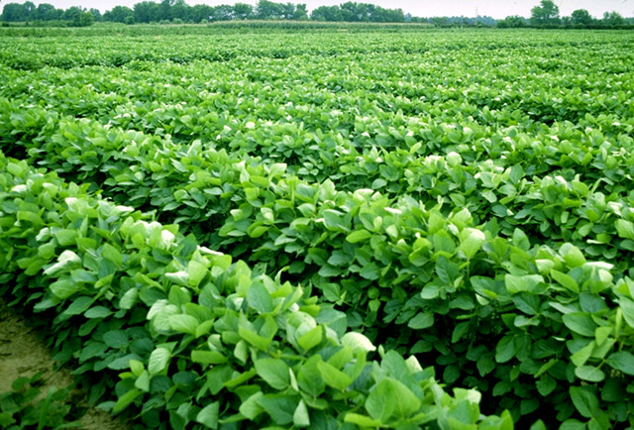
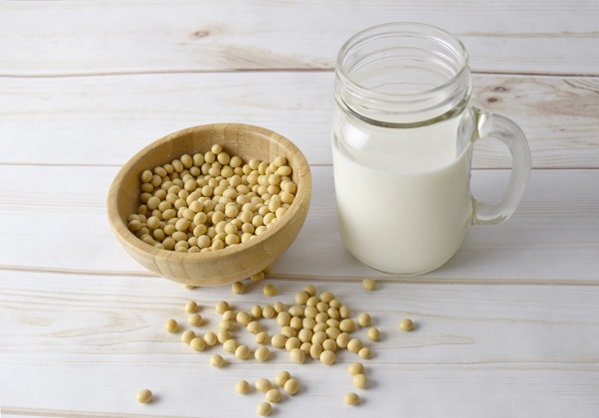
What am I?
One acre (about the size of a football field) of my product can produce 40,000 servings of tofu, 2,500 gallons of soymilk, or 82,368 crayons.

