Slide 1
Climate & Crops
Climate and weather effects on crops and farming

Slide 2
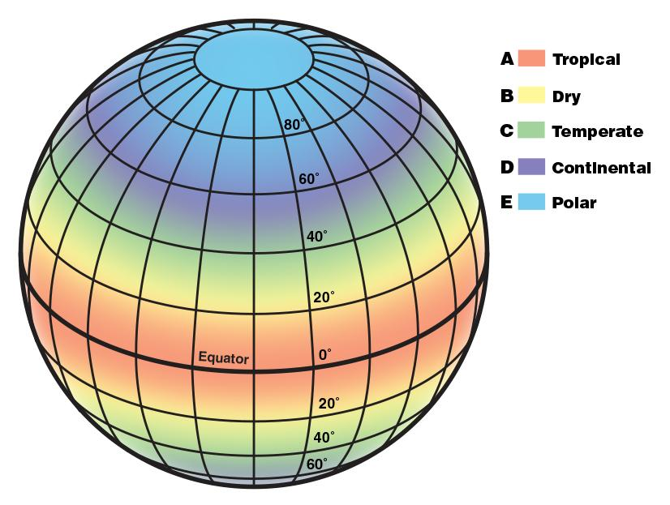
Climate Types
There are 6 types of climate zones:
Tropical
Arid
Mediterranean
Temperate
Continental
Polar

Slide 3
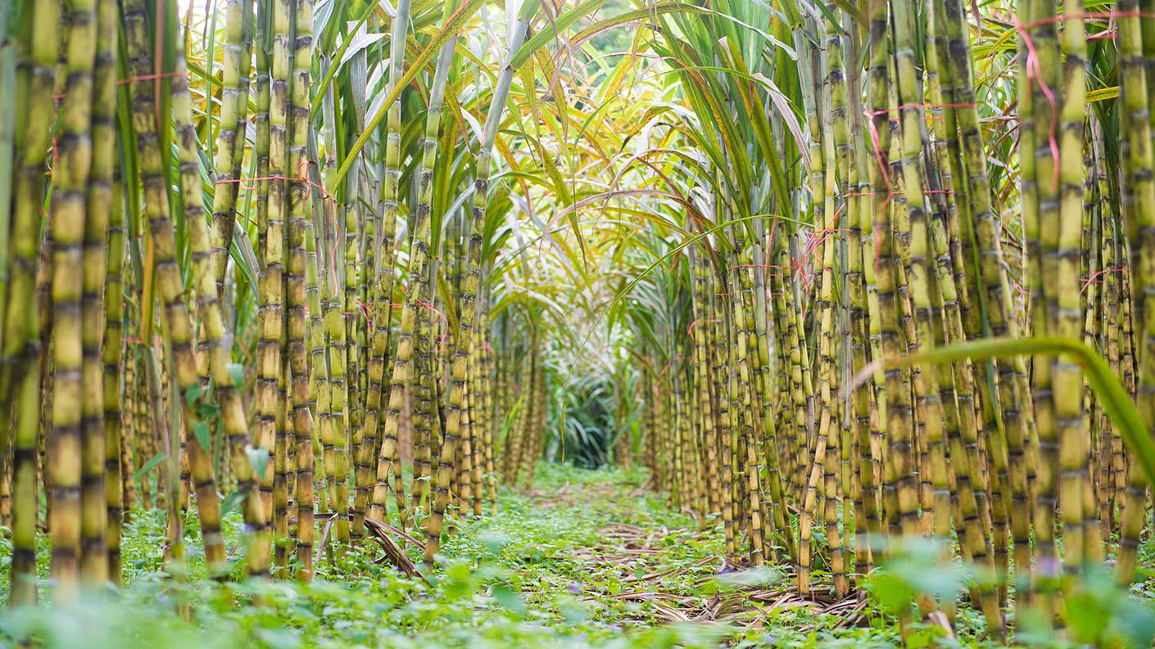
Tropical
Tropical climates are warm year-round and have a dry season and a wet season. Crops that grow best here are crops like rice, bananas, pineapple, cocoa, and sugar cane.
This soil is often acidic and lacks nutrients due to lots of rainfall.
Sugar Cane Farm

Slide 4
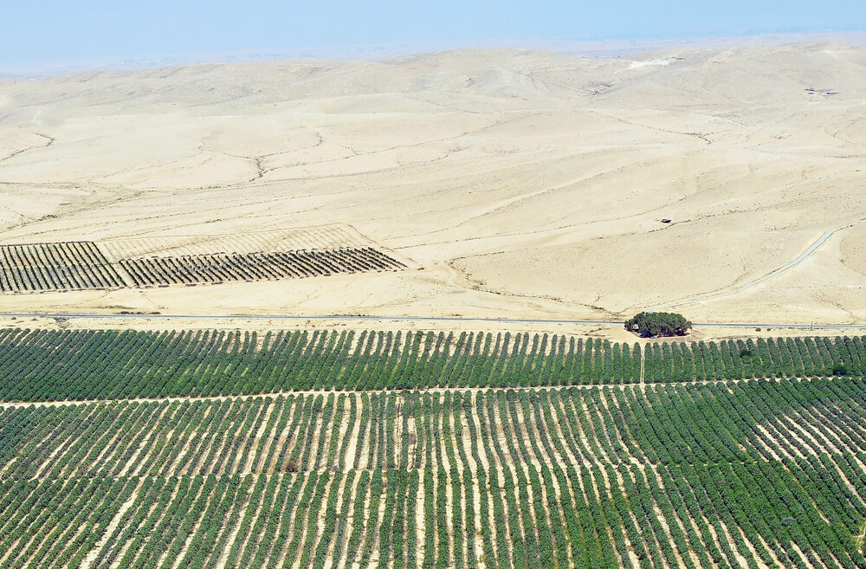
Arid
Arid climate means very little rain, like deserts. Most people wouldn't expect farms in deserts and dry areas, but farming is everywhere. The best crops that grow in dry climates are small grains, carrots, onions, grapes, and more.
The soil here is very infertile and has to have fertilizers and irrigation in order to grow crops.

Slide 5
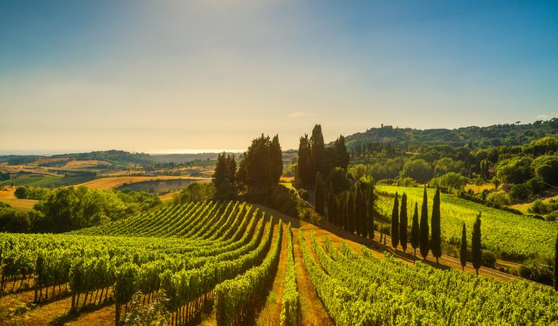
Mediterranean
The mediterranean has hot, dry summers and cold, wet winters. The crops that grow best here are cereals, rice, vegetables, and fruits.
The soil is deficient in humus (organic matter) because of the lack of rain in the summer.
Mediterranean Grape Farm

Slide 6
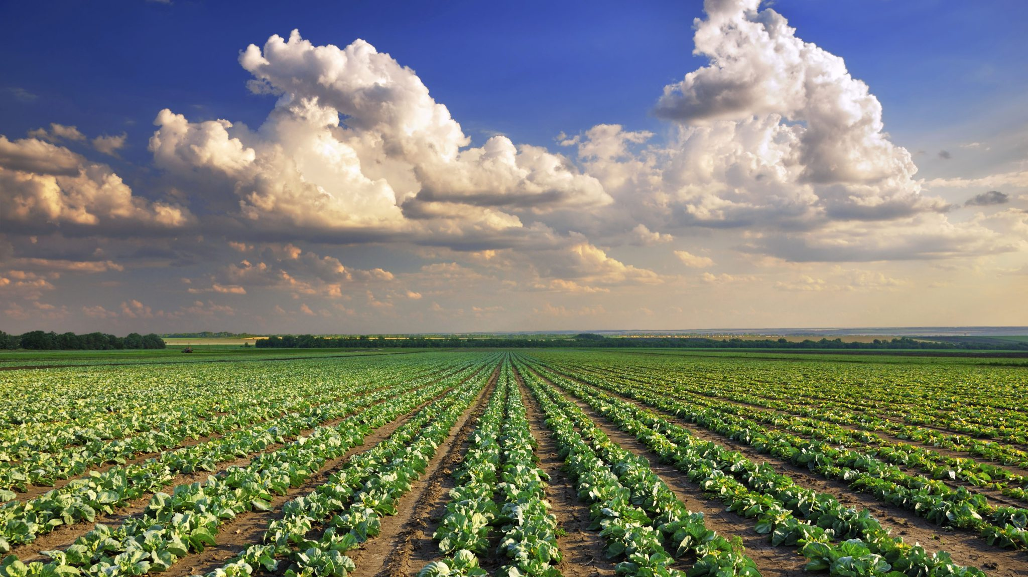
Temperate
Temperate climates have moderate rainfall throughout the year. Summers are mild to warm and winters are cold (like Iowa). Corn, soybeans, wheat, and cotton grow well here.
Temperate soils are the most fertile and have lots of nutrients.

Slide 7
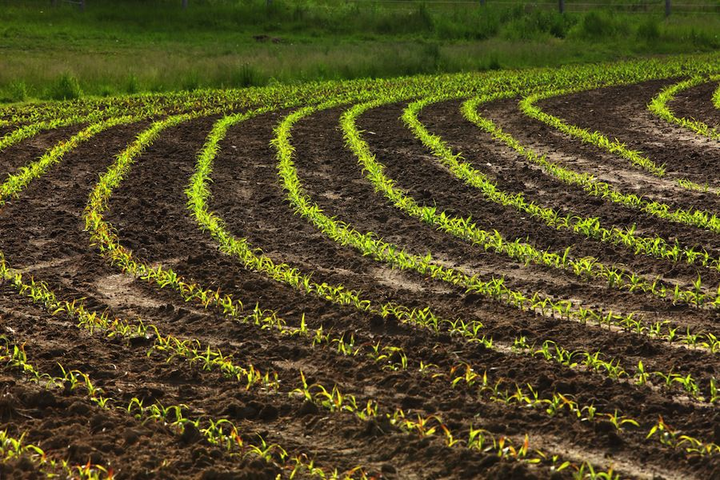
Continental
Continental climates are relatively dry. The summers are extremely hot and the winters are very cold. Corn, soybeans, and wheat grow well here
The soil is often rich in iron and aluminum oxides due to high rainfall and high latitude.

Slide 8
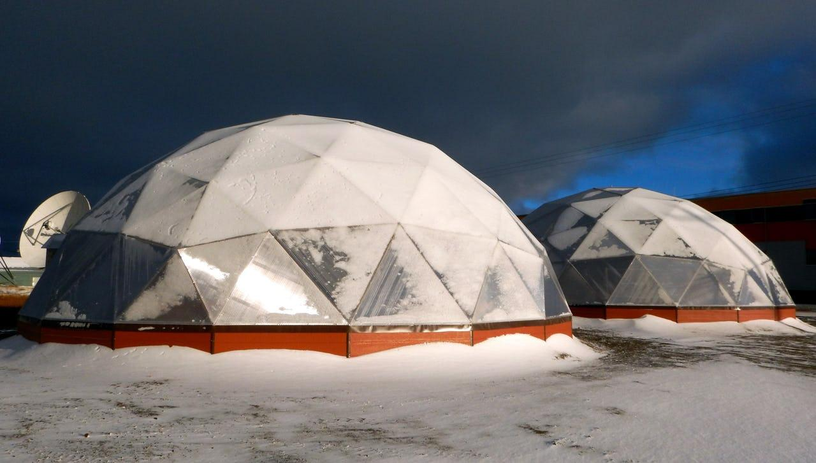
Polar
The polar climate has frigid temperatures that make it difficult to farm. but there's still ways to grow crops! Communities often find warmer areas or use greenhouses to grow food.
The soil here is called ahumic soil. It is mainly frozen sand and has no nutrients
Greenhouse in the Arctic

Slide 9
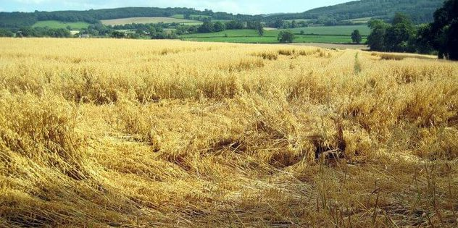
Vocabulary
Arid: climate with little to no rain, dry and barren
Temperate: climate characterized by mild temperatures
Irrigation: applying controlled amounts of water to crops
Aluminum Oxides: chemical compound of aluminum and oxygen
Deficient: not having enough, lacking
Humus: organic matter formed by decomposed plant leaves and materials

